Slide 1

Big Data Project 1
Project Presentation by Spencer Trumbore

Slide 2
Online Pet Rock Emporium (OPRE)
A console-based online store where users can browse a selection of minerals, buy some for themselves, and give them custom attributes.

Slide 3
Tech Stack
Python 3.10
MongoDb
Git/Github
VsCode

Slide 4
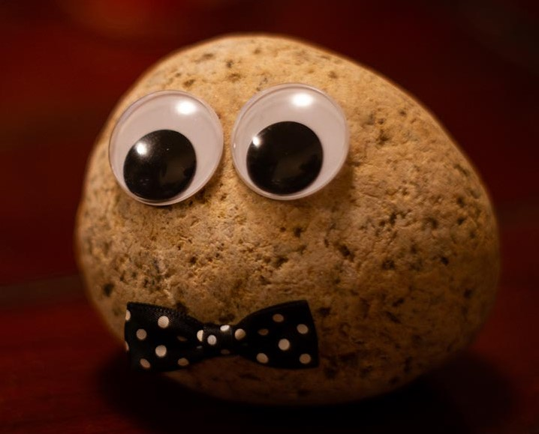
DEMO

